Slide 1
CHAPTER 4
串
Faculty of Information and Control Engineering
Huanliang Sun
Email:sunhl@sjzu.edu.cn
Office: Wu(戊2-306) 24690666
Notes:
http://www.cnblogs.com/lanxuezaipiao/p/3452579.html
http://blog.chinaunix.net/uid-24774106-id-2901288.html

Slide 2
Chapter 4
§4.1 字符数组与字符串
§4.2 串ADT
§4.3 模式匹配Pattern Matching

Slide 3
字符数组与串
  char t[5] = {'H', 'a', 'p', 'p', 'y'};
  char s[6]={'H', 'a', 'p', 'p', 'y', 0};
  char s[6]={'H', 'a', 'p', 'p', 'y', '\0'};
  A string “Happy” ended by ‘\0’ 有效长度5
  char s[80]= "Happy";
s
H a p p y \0 ? ?
s[0] s[1] s[5]
str[i] != '\0';
Notes:
Backslash double quotation marks single quotation marks single quotes

Slide 4
输入输出一个串
字符操作
getchar() //get one character
putchar() //print one character
char str[80] = "Happy";
i = 0;
while((s[i]=getchar( )) != '\n')
i++;
s[i] = '\0';
  for(i = 0; s[i] != '\0'; i++)
  putchar(s[i]);
  for(i = 0; i < 80; i++)
  putchar(s[i]);
  for(i = 0; i < len; i++)
  putchar(s[i]);
s
H a p p y \0 ? ?
s[0] s[1] s[5]
Notes:
percent

Slide 5
Example 1: 数字出现的个数 (0-9)
  #include <stdio.h>
  int main(void)
  { int count, i;
  char str[80];
  printf(“Enter a string: ");
  i = 0;
  while((str[i] = getchar( )) != '\n')
  i++;
  str[i] = '\0'; /* input ending mark of a string */
  count = 0;
  for(i = 0; str[i] != '\0'; i++)
  if(str[i] <= '9' && str[i] >= '0')
  count++;
  printf("count = %d\n", count);
  return 0;
  }
Q: 用getchar如何实现?

Slide 6
字符串操作stdio.h or string.h
  char str[80];
  scanf( ) or gets( )
  scanf("%s", str); //ends when ‘space’ ,tab or ‘enter’ gets(str); //ends at ‘enter’, which can receive ‘space’
  printf( ) or puts( )
  printf("%s", str); printf("%s", "hello");
puts(str); puts("hello"); //add ‘\n’ automatically
  gets可以接收空格；而scanf遇到空格、回车和Tab键都会认为输入结束，所有它不能接收空格。
Notes:
gets可以接收空格；而scanf遇到空格、回车和Tab键都会认为输入结束，所有它不能接收空格。

Slide 7
#include <stdio.h>
int main( )
{ char str[80];
gets(str);
puts(str);
puts("Hello");
return 0;
}
#include <stdio.h>
int main( )
{ char str[80];
scanf("%s", str);
printf("%s", str);
printf("%s", "Hello");
return 0;
}
Programming
ProgrammingHello
Programming
Programming
Hello
Programming is fun!
ProgrammingHello
Programming is fun!
Programming is fun!
Hello

Slide 8
Copy, Catenation , Comparison,
get Length of a string
  拷贝Copy：strcpy(str1, str2)
  连接Catenate：strcat(str1, str2)
  比较Compare：strcmp(str1, str2)
  长度Get length：strlen(str)
  string.h

Slide 9
strcpy(str1, str2);
  char str1[20];
  char str2[20] = “happy”;
strcpy(str1, str2);
  str1
h a p p y \0
strcat(str1, str2);
# include "stdio.h"
# include "string.h"
int main(void)
{ char str1[80], str2[20];
gets(str1);
gets(str2);
strcat(str1, str2);
puts(str1);
return 0;
}
Input:
Let us
go.
Let us go.
str1： Let us \0
str2：go.\0
str1： Let us go.\0
str2：go.\0

Slide 10
strcmp(str1, str2)
Rules： 字典序Lexicographic order (ASCII code)
  if str1 == str2 ，return 0；
  if str1 > str2 ，return 1；(in VC)
  if str1 < str2 ，return -1； (in VC)
char s1[20] = "sea";
  strcmp(s1, "Sea"); 1
  strcmp("Sea", "Seat"); -1
  strcmp("Sea", "Sea"); 0
  strcmp (“Mannie", “Bosun"); 1
  strcmp (“Bosun", “Mannie"); -1
Notes:
ˌleksɪkə'græfɪk

Slide 11
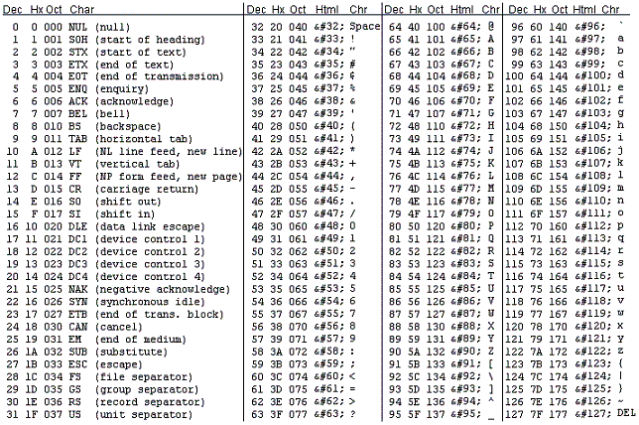

Notes:
[ˈdesɪml] small letter capital letter

Slide 12
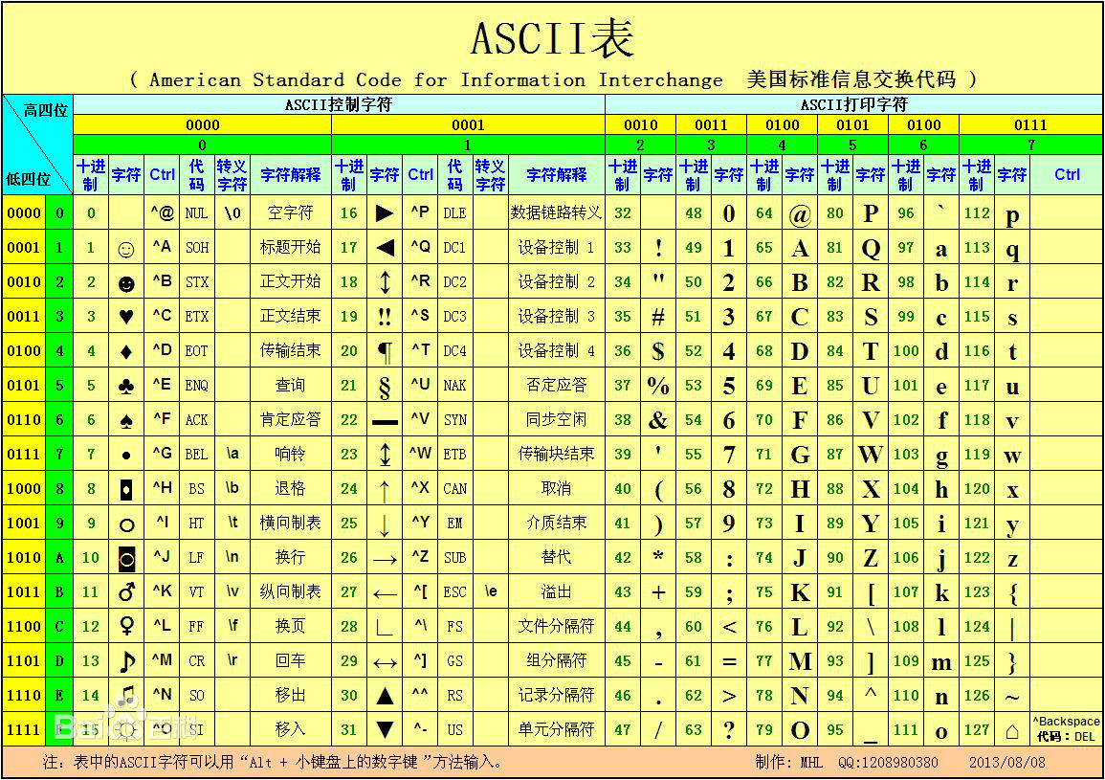

Slide 13
strlen(str) get the length of str except for‘\0’.
  char str[20]=“How are you?”
  strlen(“hello”) the value is：
  strlen(str) the value is：
5
12
puts(str) output a string stdio.h
gets(str) input a string（separated by enter） stdio.h
strcpy(s1,s2) s2 ==> s1 string.h
strcat(s1,s2) s1 “+” s2 ==> s1
strcmp(s1,s2) if s1“==”s2， return 0
if s1 “>” s2， >0 if s1 “<” s2， <0
strlen(str) get the length of a string ，except for‘\0’

Slide 14
Example 2: 获得最小串
#include <string.h>
int main( )
{ int i;
char sx[80], smin[80];
scanf("%s", sx);
strcpy(smin,sx);
for(i = 1; i < 5; i++){
scanf("%s", sx);
if(strcmp(sx, smin)<0)
strcpy(smin,sx);
}
printf("min is %s\n", smin);
return 0;
}
int main( )
{ int i;
int x, min;
scanf("%d", &x);
min = x;
for(i = 1; i < 5; i++){
scanf("%d", &x);
if(x < min)
min = x;
}
printf("min is %d\n", min);
return 0;
}
2 8 -1 99 0
min is –1
tool key about zoo sea
min is about

Slide 15
/* a[0] to a[n-1] is the array to sort */
#include <stdio.h>
#define ARR_SIZE 30
void sort (float a[], int n);
void swap(float *x, float *y);
main()
{ int k, n;
float a[ARR_SIZE]={0.0};
printf("Input the number of score:");
scanf(" %d", &n);
printf("Input %d score:", n);
for (k=0; k<n; k++)
scanf("%f", &a[k]);
printf("The original order is:\n");
for (k=0; k<n; k++)
printf("%f\n", a[k]);
sort (a, n);
printf("The new order is:\n");
for (k=0; k<n; k++)
printf("%f\n", a[k]);
system("PAUSE");
}
Example 3:
给一个选择排序的例子，按名字排序

Slide 16
按姓名排序
void sort (float a[], int n)
{ int i, j, iMin;
/* advance the position through the entire array */
/* (could do j < n-1 because single element is also min element) */
for (i = 0; i < n-1; i++) { /* find the min element in the unsorted a[j .. n-1] */
iMin = i; /* assume the min is the first element */
for ( j = i+1; j < n; j++) {/* test elements after j to find the smallest */
/* if this element is less, then it is the new minimum */
if (a[j] < a[iMin])
iMin = j; /* found new minimum; remember its index */
}
if(iMin != i)
swap(&a[i], &a[iMin]);
}
}
void swap(float *x, float *y)
{
float temp;
temp = *x;
*x = *y;
*y = temp;
}

Slide 17

Experiment 4-1 字符串基本操作
问题:
给定用函数fgets从文件读取;（文件操作）
实现字符串排序。 (给定选择排序算法)

Slide 18
§4.2 String ADT
Typedef struct SeqString { /* Type definition*/
int MAXNUM; /* the maximum length */
int n; /* the length of the string，n≤MAXNUM */
char *c;
}SeqString, *PSeqString;
String createNullStr (void) /*Create a null string*/
int IsNullStr ( String s ) /*if s is an empty string, isNull returns 1, otherwise 0*/
int length ( String s ) /*return the length of a string*/
String strcat (String s1, Sting s2 ) /*Catenate two strings */
String subStr (String s, int i, int j ) /*Return a substring with the length j from location i. */
int index(String s1, String s2 ) /*if s2 is the substring of s1, return the first location, otherwise return -1 , Pattern Matching*/

Slide 19
Example
s = “abcdefg”
s.n = 7
s.c
a
b
c
d
e
f
g
0 1 2 3 4 5 6 MAXNUM-1

Slide 20
ADT —— Create a null sequence string
PSeqString createNullStr_seq( int m )
{
PSeqString pstr = (PSeqString)malloc(sizeof(struct SeqString));
if (pstr != NULL)
{
pstr->c = (char* )malloc(sizeof (char)*m);
if (pstr->c ！= NULL) {
pstr->n = 0;
pstr->MAXNUM = m;
return (pstr);
}
else free (pstr);
}
printf("Out of space!!\n");
return NULL;
}
struct SeqString {
int MAXNUM;
int n;
char *c;
};

Slide 21
ADT by linked list
struct StrNode; /* linked string node */
typedef struct StrNode *PStrNode; /* pointer node type*/
struct StrNode { /* Node*/
char c;
PStrNode link;
};
typedef struct StrNode *LinkString; /* linked string*/
字符串结尾？长度？

Slide 22
Linked string
s
Without head node
a
b
c
d
^
s
With head node
a
b
c
d
^
s
Circular linked list
a
b
c
d

Slide 23
Operations of a linked string
Create a null linked string
Catenate two strings
Get the substring
Delete substring
Insert substring
Substring locate [Pattern Matching]
Get the length of a string

Slide 24
Create a null linked string with head node
LinkString createNullStr_link( void )
{
LinkString pst;
pst = (LinkString)malloc( sizeof(struct StrNode) );
if (pst!=NULL)
pst->link = NULL;
else
printf("Out of space! \n"); /*failure*/
return (pst);
}

Slide 25
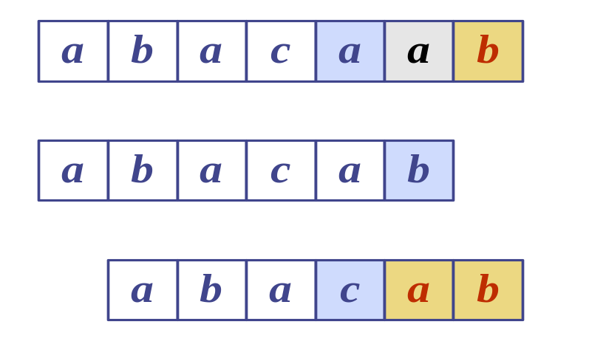
Pattern Matching
§4.3 Pattern Matching
T:
P:
Notes:
Pattern Matching

